Slide 1
Draft Lake County Energy Strategy
Constraints, Framework, and Recommended Next Steps
Board of Supervisors · September 15, 2026
Ben Rickelman, Deputy County Administrative Officer
Prepared through the Ad Hoc Energy Policy Committee
Notes:
Draft presentation to the Board, 9/15/26. Nothing here is adopted policy — the ask is discussion and direction on the items in Part III.

Slide 2
1
PURPOSE
What this presentation covers
I
II
III
The draft strategy
Next steps
Limits on local government
A high-level walk through the County Energy Strategy, section by section. Draft Energy Strategy is under legal review.
Recommended actions, split between exploratory and commercial projects. Energy Strategy for Board consideration in October.
What the County cannot do. Legal and financial limits that are settled, not arguable.
Constraints come first on purpose
Most of what has been proposed to the County over the past year fails on a legal or financial limit rather than on merit. Naming those limits early is what makes the rest of the policy credible, and it is the fastest way to move the conversation to the tools that do work.
Notes:
Frame the deck: three parts. Emphasize that the constraint section is not a list of excuses — it is what keeps the County from spending a year on instruments that will not survive review.

Slide 3
2
PART I — THE BOUNDARIES
Five limits that shape everything else
1
Ownership — The County cannot hold equity in, or share revenue as an owner of, private generation*
2
Commodity — The County cannot take power at cost and resell it into the market
3
Wires — Acquiring PG&E's distribution system is not financeable at any modeled price
4
Permitting — A developer may elect State certification; local permits are then displaced
5
Money — A fixed, formula-driven payment applied to every project reads as a tax
*Public purpose exception
Notes:
These five are the recurring collision points between what has been proposed and what a general law county can actually do. Everything in Part I expands one of these rows.

Slide 4
3
PART I — THE BOUNDARIES
The County cannot own merchant generation
No equity in private generation
No buying and reselling power
A county is not a public utility or load-serving entity under state law; it has no market entry point.
State law defines an energy supplier as a utility, an Electric Service Provider, or a Community Choice Aggregator. Counties are not on the list.
NCPA members are public agencies with their own or retail load. Absent a CCA or Public Utility District, the County has no market credit or commodity reserve.
Cal. Const. art. XVI, § 6 bars a subdivision of the State from holding stock in a corporation.
The same section bars gifts of public funds and lending County credit to a private venture.
A general law county holds only the powers the Legislature has granted. No statute authorizes county equity in merchant generation.
What is allowed
County ownership of an asset built for a public resilience purpose rather than for market return. A microgrid, or the FLASHES pumped-hydro project may work. The test is the purpose the asset serves, not the technology.
Notes:
Pillar 2 and Pillar 3 of the CAP draft both assume some form of County equity or merchant share. This is the constitutional and federal wall those run into. The resilience carve-out is real and the County is already using it.

Slide 5
4
PART I — THE BOUNDARIES
Buying PG&E's system does not pencil out
$307.7M
PG&E's net assessed value in Lake County, FY 2024-25. The floor of the range
0.37x
Coverage at $690M bond par (scenario D). A revenue bond covenant typically requires 1.25x
+27.8%
Day-one rate increase at $690M bond par, 5.5% financing. About $96 more per meter per month
$112M
Maximum price the system supports at 1.25x coverage
Bondable threshold: 1.25x. No scenario clears 1.00x.
Required bond par runs $466M to $850M. The largest bond in County history is $20.64M. Driving operating cost to $400 per meter and removing the departing-load surcharge entirely still leaves coverage at 0.96x. The conclusion does not turn on either contested assumption.
Notes:
This is the July 28 model rerun on the revised price range. The single most important exhibit is the affordable-price ceiling: roughly $112M against a $307.7M floor. Wildfire liability makes underwriting unlikely regardless of the coverage math.

Slide 6
5
PART I — THE BOUNDARIES
Wildfire risk closes the financing path
Strict liability assumes that if a utility’s equipment starts a fire, it pays for the damage, even if it did nothing wrong. Most other states make victims prove negligence first. California does not, and the rule applies first to public entities. A County utility would carry that exposure on a fire-exposed rural system, with only ratepayers behind it.
No modern precedent at this scale
The State backstop does not reach a PUD
Trinity PUD, formed in 1982, is the last California PUD organized to take over an electric distribution system. It serves about 7,300 meters. Lake County has 36,343.
The AB 1054 Wildfire Fund pays only three participating electrical corporations: PG&E, Southern California Edison, San Diego Gas & Electric. Publicly owned utilities are not eligible. SB 254 added $18B but not eligibility.
Why price is not the fix
A lower acquisition price would improve the coverage ratio. It would not give the County a wildfire liability backstop or a rating agency willing to underwrite one. Revenue bonds for this purchase are unlikely to be marketable at any price the model produces.
Notes:
Wildfire liability is the obstacle the price sensitivity does not capture. Two anchors if asked: Trinity PUD (1982) is the last PUD in California organized to take over an electric distribution system — about 7,230 meters against our 36,343 — and Kirkwood Meadows PUD, formed 1985, bought a roughly 900-connection system from Mountain Utilities in 2011, so it is not a counterexample at scale. On the backstop: the Wildfire Fund's three participants are all IOUs. The April 2026 SB 254 report floats broader catastrophe models that could include local publicly owned utilities, but nothing has been enacted. Municipalization success rates are contested — APPA and the Edison Electric Institute publish very different counts — so avoid citing a number. On the liability point: California is effectively alone in letting fire victims recover from a utility without proving negligence. Inverse condemnation began as a rule for public entities, so a County PUD's exposure is the base case, not an extension.

Slide 7
6
PART I — THE BOUNDARIES
State permitting limits what the County can require
AB 531 (2025) extended California Energy Commission (CEC) opt-in certification to geothermal powerplants of any size; whether the wellfield is inside the certificate is a CEC related-facilities call, not statute. SB 254 (2025) separately repealed the Laws, Ordinances, Regulations, and Standards (LORS) conformity finding and the override that went with it.
Cannot declare an ordinance binding
Cannot use road access as leverage
Road repair, haul routes, and maintenance agreements are legitimate County concerns and the place to secure them is the CEC proceeding, where the CEC adopts and enforces the conditions. A State certificate takes the place of County permits and overrides County rules. Using a road permit to demand terms the CEC didn't adopt would be an end-run the law does not allow.
There is no LORS conformity finding left in the opt-in chapter. Asserting one invites a correction on the record that distracts from the conditions the County is seeking.
What still works
Early, substantive participation in the State proceeding, where mitigation and public health and safety conditions are set. No geothermal project has filed under this pathway yet; those that do must have a community benefits agreement.
Notes:
The distinction to hold onto: preemption changed the forum, not the County's interests. What it did remove is the LORS hook the CAP toolbox is built on.

Slide 8
7
PART I — THE BOUNDARIES
A fixed revenue-share formula reads as a tax
The legal stack
Holds up
Proposition 26: any local levy is a tax unless an exception applies, and the County carries the burden of proof.
Sheetz v. County of El Dorado (2024): nexus and proportionality now reach legislatively adopted conditions.
Jacks v. City of Santa Barbara (2017): a charge for use of County property is capped at the value of what is conveyed.
Road damage and restoration
Traffic control and inspection
Actual-cost recovery for staff time
Negotiated, project-specific terms
Does not
$/MWh output-indexed charges
Standardized revenue-share schedules
A participation fee framed as a permit condition
The County's position: benefits above standard taxation are secured through voluntary, project-specific agreements supported by a documented nexus. A published framework is an illustrative range that informs negotiations.
Notes:
This is the single most consequential correction to the CAP draft. The intuition that a uniform template is safer than negotiating each deal is exactly backwards after Sheetz.

Slide 9
8
PART I — THE BOUNDARIES
Districts, staffing, and grants do less than assumed
Special districts
Staffing
Grants
Community Facilities District (CFD) elections with under 12 registered voters are by landowner, one vote per acre. It cannot be formed over the landowner's objection.
A CFD cannot fund services already provided, or finance County acquisition of a system the County cannot own.
Enhanced Infrastructure Financing District: capital only. No operations.
Formation runs into six figures before any revenue.
The County is under a hiring freeze.
Energy navigator and coordinator roles are uncommon in a small rural county; each would need documented local demand.
Recurring obligations must go to existing staff, cost recovery, or secured outside funding, or they are noted rather than adopted.
Grants, generally, fund capital projects, planning studies, and program delivery.
Grants, generally, do not fund County formation, legal, or negotiation costs.
Notes:
Not an argument against special districts generally — an argument against the specific work the proposal assigns them. The CFD landowner-vote point is the one that surprises people.

Slide 10
9
PART I — THE BOUNDARIES
What remains is narrower, and real
Development agreements
Community benefits agreements
Negotiated project by project. The path Imperial, Kern, and Riverside have used.
The instrument where the CEC certifies and no County permit remains.
State proceeding participation
Applicant-funded cost recovery
Early and substantive, where conditions are set.
Scales with activity; no standing appropriation required.
Energy Element
Hearings, consistency findings, and tribal consultation a standalone policy would bypass.
Impact of The Geysers
Constellation is the County's largest property taxpayer at $593 million assessed in 2025, its sixth largest employer with 271 employees, and a source of annual royalties. The gap with Sonoma reflects that 13 of the 15 of The Geysers plants sit there.
Notes:
End Part I on what the County can do. The Geysers framing correction matters because the proposal's urgency rests partly on a premise that the numbers do not support.

Slide 11
10
PART II — THE DRAFT STRATEGY
Principles, risks, and how the document is built
Guiding principles
Risks, addressed by design
Structure
The County's interest is substantive, not territorial.
Neutral as to technology and resource.
Benefits through voluntary, project-specific agreements with a documented nexus.
No equity, no lending of credit, no operating risk in merchant generation.
Tribal consultation is required.
Prop 26 and Sheetz exposure on negotiated payments.
Asserting authorities that no longer exist. The LORS conformity finding.
Unconstitutional conditions and preemption.
CEQA Segmentation where review is split between State and County.
Capacity, under a hiring freeze and fiscal uncertainty.
Organized by what the County controls, moving outward.
Posture and participation come first: no new authority, no ordinance, no appropriation.
Later sections depend on the County holding a discretionary approval.
Nothing depends on authority the County lacks or capital it cannot raise.
Notes:
The structural logic is the argument: the County's position should not collapse if a developer elects State certification. That is why posture and participation lead.

Slide 12
11
PART II — THE DRAFT STRATEGY
Posture and Participation for Environmental Review
Posture
Participation
Adopt a standing position of non-opposition to pathway choice. A preference is not a condition of County support.
Make speed and predictability the primary defense of local control and publish permit cycle times.
Formal early participation in every State proceeding sited in Lake County: request the pre-filing meeting, designate one point of contact, file at scoping the draft environmental document.
Treat CEC scoping and the draft environmental document as the County's hearings. Issues the County doesn't put on the record don't get analyzed and can't be raised later.
Comment in the form of proposed conditions, not objections. A letter urging denial gives the CEC nothing to adopt; specific, feasible mitigation language may be adopted.
Neither section requires new authority, an ordinance, or an appropriation. Anything that does takes months of hearings; a CEC (California Energy Commission) scoping window could close in weeks.
Notes:
If the Board takes one operational point from the policy, it is that the leverage is at CEC scoping, not at the County's later use permit hearing. On lead agency, 15051(b)(1) is a presumption, not a rule, and it is subordinate to the (b) test of greatest responsibility for the project as a whole. In Center for Biological Diversity v. County of San Bernardino (2016) 247 Cal.App.4th 326 a limited-purpose water district was upheld as lead agency over the county, so do not present County lead status as automatic.

Slide 13
12
PART II — THE DRAFT STRATEGY
County–State Relationship
These would all require an investment of staffing and / or contracting resources
Maintain a standing LORS (Laws, Ordinances, Regulations, and Standards) compendium, every applicable ordinance, General Plan policy, standard, and map, with citations and factual basis.
Position the County as the CEC's data source: hazard and fire mapping, evacuation constraints, haul routes, water supply, labor market, AB 52 tribal contacts.
Publish a fiscal-impact methodology in advance.
  The CEC must find net local benefit for a State certified project; SB 254 made that a rebuttable presumption. The County supplies the record that answers it.
Keep a roster of local community-based organizations; the opt-in statute requires an agreement with one, and the County itself qualifies.
Notes:
The fiscal-impact methodology is the item with the highest leverage per dollar — it is the record the CEC needs for a finding it is required to make.

Slide 14
13
PART II — THE DRAFT STRATEGY
Development and Community Benefits Agreements
Modernize the County's development agreement ordinance (Article 69). Adopted in 1988, it assumes every project also needs a County rezone or use permit. Projects the State certifies may not, so the update allows a standalone agreement and cleans up outdated findings.
Authorize the County to sign community benefits agreements for State-certified projects. State law requires a developer to sign one before the CEC can certify a project, and the County can be the other party, but only if its ordinance allows it and the authority is in place before the CEC finishes its review.
Update the Master Fee Schedule so applicants pay the actual cost. The current development agreement fee is a 20-hour Planning deposit set in 2017, and only Planning staff time can be billed against it, not County Counsel, outside counsel, or consultants. An update would recover actual cost from a refundable deposit and adds a line for community benefits agreements.

Slide 15
14
PART II — THE DRAFT STRATEGY
CEQA practice
CEQA
Where the County is lead, scope the document to the whole of the action: wellfield, pipelines, the transmission line to the grid, and haul routes.
Request at scoping that the California Energy Commission's environmental review cover the wellfield, not just the power plant.
Require full buildout disclosure as a completeness condition.
Maintain a standing project list for the cumulative baseline.

Slide 16
15
PART II — THE DRAFT STRATEGY
Affirmative siting
Affirmative Siting
Cost flag: a comprehensive siting map with a programmatic EIR is an estimated $2–4 million undertaking requiring outside contracting and outside funds. It would also place the County in the lead agency role for the program-level analysis and give later project review a County document to tier from.
Publish a County siting map identifying where energy development could be well suited. Screened for disturbed ground, resource quality, leasehold, interconnection, haul routes, and sensitivity. Pre-clear standards inside those areas. - Requires Outside Funding
Maintain current interconnection and transmission constraint information. - Requires Outside Funding
Recruit downstream and co-located end users needing baseload power or direct-use heat.
Notes:
Affirmative siting is the most expensive item in the policy and also the one that does the most work — it is simultaneously the setback defense, the tiering document, and the recruitment tool.

Slide 17
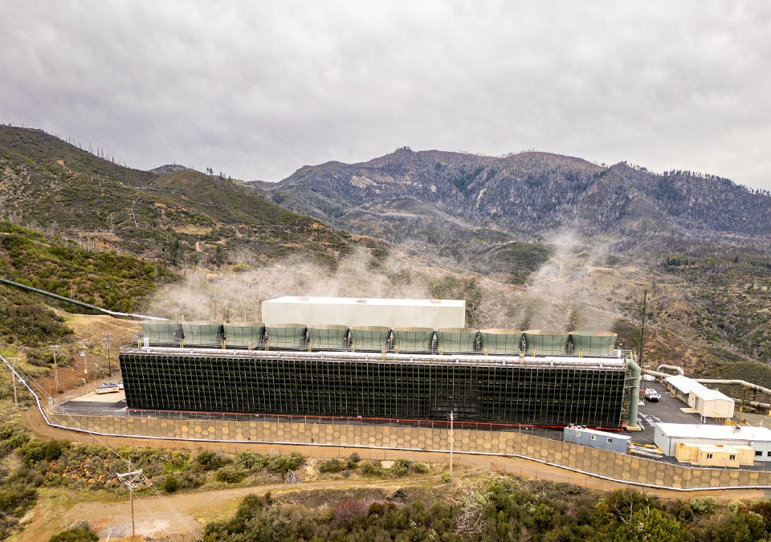
16
PART II — THE DRAFT STRATEGY
Geothermal setback
Geothermal setback
The setback holds against CalGEM-led exploratory drilling, but not against opt-in certification that includes the wells.
Anchor it in General Plan policy, not zoning alone; otherwise, it’s exposed to a consistency attack.
Notes:
Flag for discussion: absolute versus criteria-based. Maximum protection carries maximum de facto ban and takings exposure.

Slide 18
17
PART II — THE DRAFT STRATEGY
Capacity and funding
Capacity and funding
Every commitment needs to carry a named owner and an identified funding source.
Applicant cost recovery funds County lead review and State participation.
Development agreements cover project-specific costs.
Competitive grants fund the planning work products.
Recurring obligations are County operating costs.

Slide 19
18
PART III — NEXT STEPS
Exploratory projects
Board-adopted Energy Strategy
Board / Administration
1
The framework above, adopted by the Board, establishing how the County deals with energy projects.
Road impact and use agreement
2
Public Works / Counsel
Short template signed before drilling: haul routes, a pre-work road survey, applicant pays for damage, with insurance and indemnification behind it.
Written CalGEM position on geologic hydrogen
Community Development / Counsel
3
CalGEM treats geologic hydrogen as geothermal, but only informally. The County should request that in writing before a filing arrives, not after.
Zoning Ordinance Updates
Community Development
4
Article 27 (Uses) and Article 68 (Definitions) require amendment(s) to reflect proposed projects.
Notes:
Eight large-scale projects have expressed interest — geothermal, geologic hydrogen, pumped hydro, and wind. Formal exploratory applications are expected soon.

Slide 20
19
PART III — NEXT STEPS
Commercial projects: the first steps, in order
Update the development agreement ordinance (Article 69)
Community Dev. / Counsel
1
Adopted in 1988, it assumes a County permit. The update allows standalone agreements and community benefits agreements for State-certified projects.
Estimate staff cost and update the Master Fee Schedule
Community Dev. / Auditor
2
The hourly rate is settled; the hours behind the deposit date to 2017. Recover actual cost, including Counsel and consultants, from a refundable deposit.
Extend cost recovery to State-certified projects
3
The County cannot charge a fee on a project the State permits. But if a developer asks the County to negotiate a community benefits agreement, the developer pays the County's actual cost of doing so, the same as any County application.
Administration / Counsel
Model agreement and term sheet
4
Administration / Counsel
A reusable template and checklist, so the first negotiation produces a tool for the next and every applicant sees the same process.
Wind standards in the zoning ordinance
Community Development
5
Section 27.13(aj) currently reads “None.” Standards need to be in place before the first wind application (Morgan Valley) is filed.
Notes:
Items 1 through 4 are sequential and each depends on the one above it. The reason the sequencing matters: if the CEC certifies a project under AB 531, the County has no permit to grant. A community benefits agreement is the only instrument it holds, and the County aims to execute it before the Commission’s record closes. Owners shown are staff’s proposed assignments.

Slide 21
20
PART III — NEXT STEPS
Commercial projects: near term and ongoing
General Plan consistency
Community Development
6
State law requires a development agreement to match the General Plan. Until the Energy Element is adopted, the County needs a stated basis for that finding.
Fiscal impact methodology
7
A published method for measuring what a project costs and brings the County. It is the record the CEC needs for its required finding of net local benefit.
Administration
Pre-application meetings and full buildout disclosure
Community Development
8
Meet developers before they file, and require them to describe the whole project, every phase, not just the first one.
Coordination with other agencies
Community Development
9
Standing protocols with State and regional agencies beyond CalGEM, the State’s oil, gas, and geothermal regulator, so each project doesn’t start from scratch.
Standing records
10
A compendium of County rules, a running list of projects for cumulative review, a roster of community organizations, and public reporting of permit cycle times.
Administration / Community Dev.

Slide 22
Draft Lake County Energy Strategy
Constraints, Framework, and Recommended Next Steps
Board of Supervisors · September 15, 2026
Ben Rickelman, Deputy County Administrative Officer
Prepared through the Ad Hoc Energy Policy Committee
Notes:
Draft presentation to the Board, 9/15/26. Nothing here is adopted policy — the ask is discussion and direction on the items in Part III.

