Slide 1


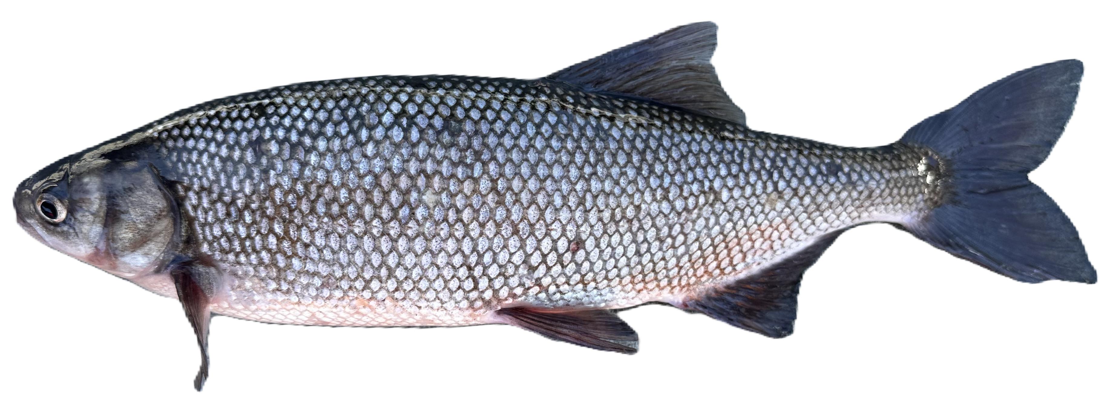

Community Science Hitch Spawner Observation Survey
2026 Summary & Outcomes
Presentation By: Chris Childers, Hitch Program Coordinator & Taylor Woodruff, Hitch Program Technician
9/22/2026

Slide 2
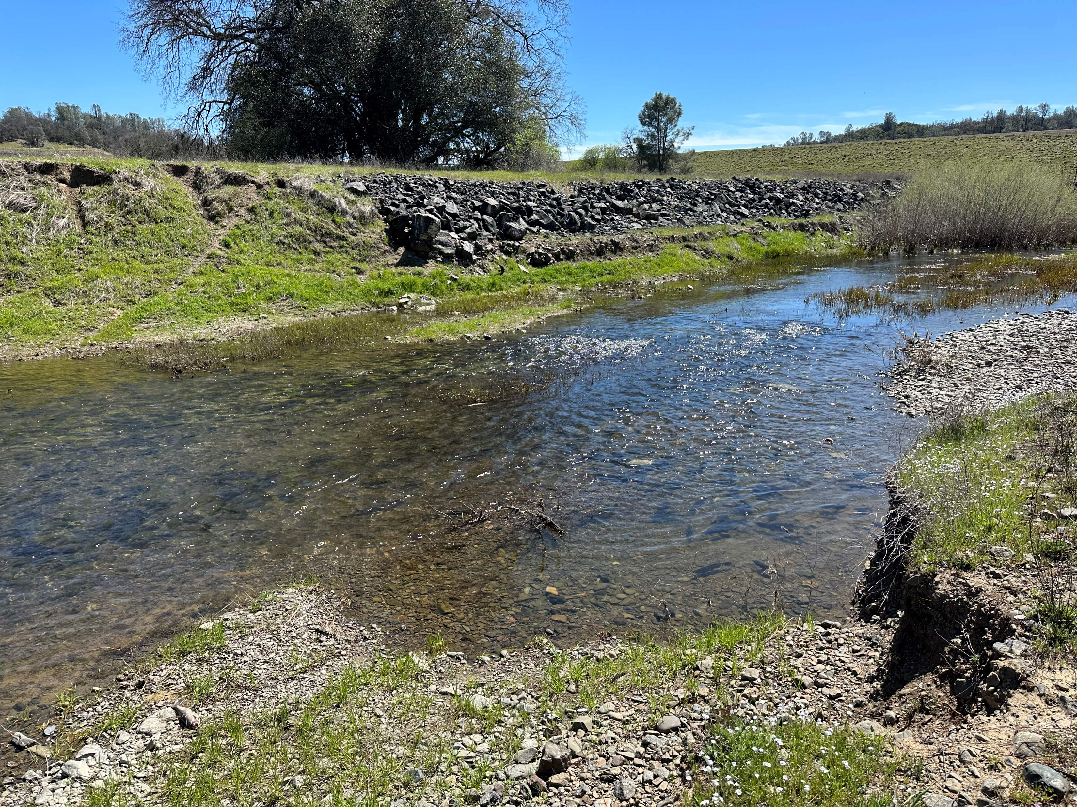
What Is Community Science?
Definition
A form of research that provides everyone—regardless of their background—an opportunity to contribute meaningful data to further our scientific understanding of key issues
In simple terms community science is public participation in scientific research
Adobe Creek 4/11/23

Slide 3
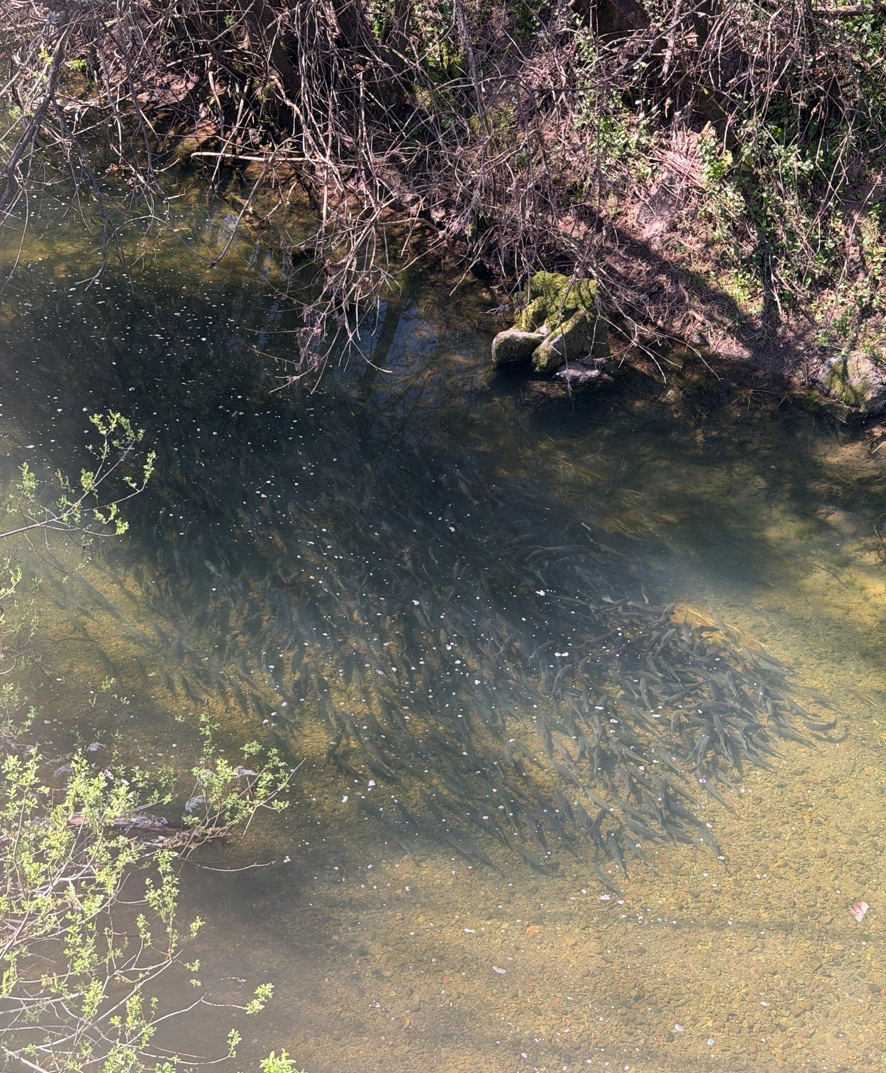
PURPOSE / GOALS
Monitor relative population trends over time to help with long term conservation and management decisions
Monitoring is beneficial for presence/absence before and after creek restoration projects and barrier removal efforts
Community Involvement education / outreach / engagement
To understand what extent hitch occupy creeks, what creeks are occupied and how far upstream they migrate to spawn
  When do hitch enter specific creeks?
  How long do hitch occupy each creek?
Adobe Creek 3/16/26 (T. Woodruff)

Slide 4
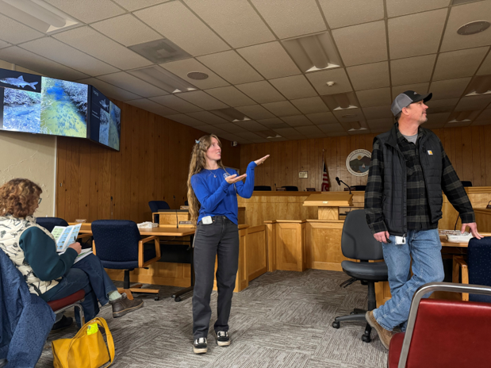
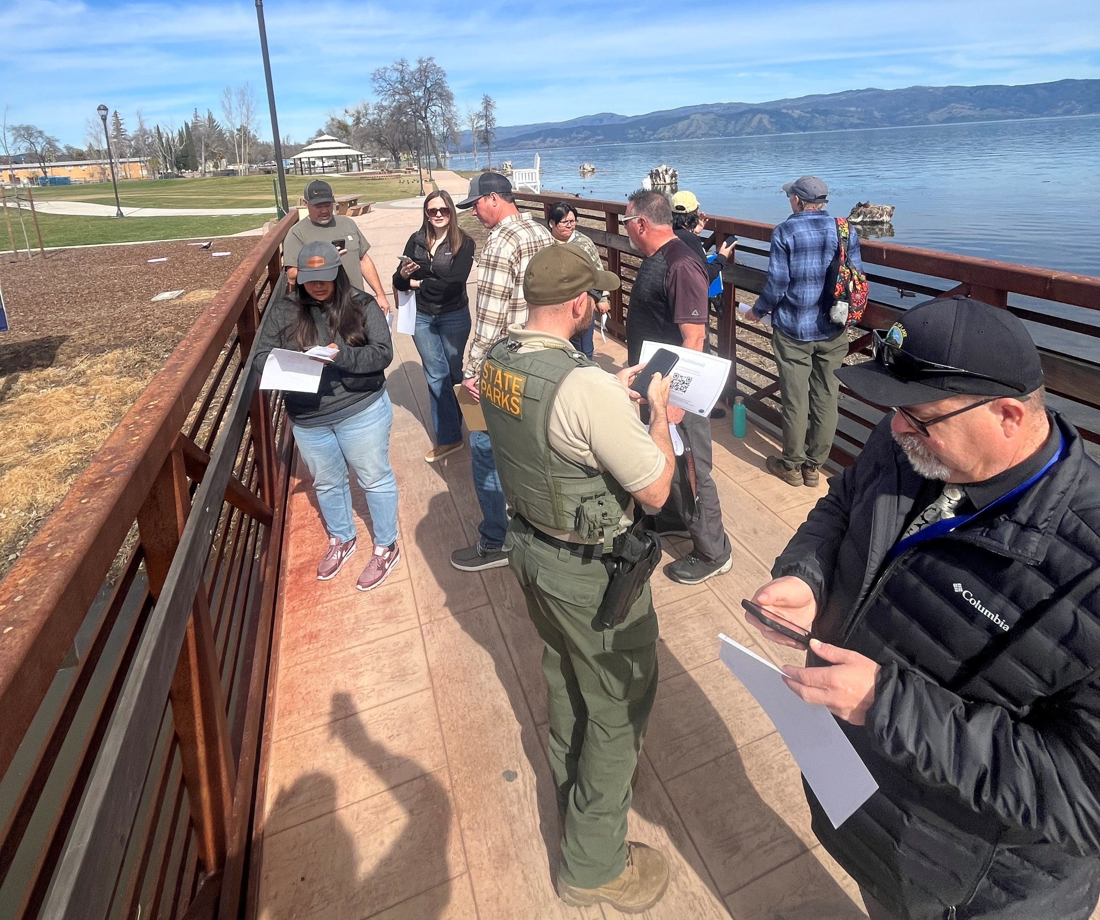
DESIGN
All volunteers are required to attend training once yearly
  In person and field components
Sites are pre-selected for repeatability
Locations monitored once a week for 10 weeks starting March 9th
  Bridge crossings
Adopt a pre-selected public site each year
Private property sponsored sites 5-10 year commitment
2/18/26 (M. Page)
2/27/25 (A. Balletto)

Slide 5
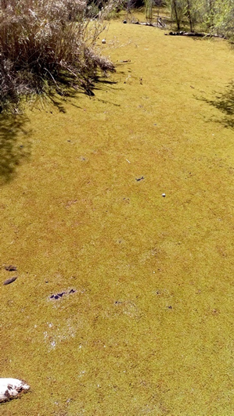
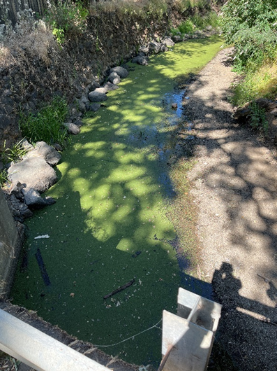
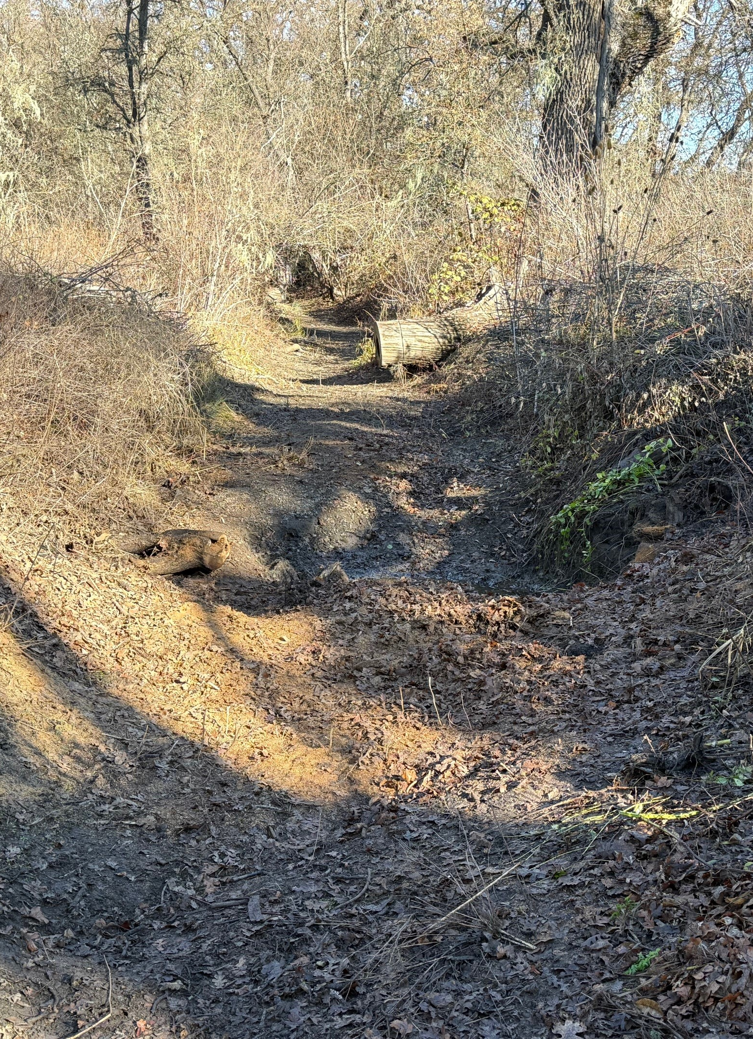
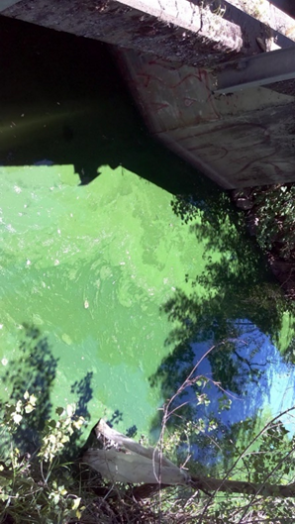
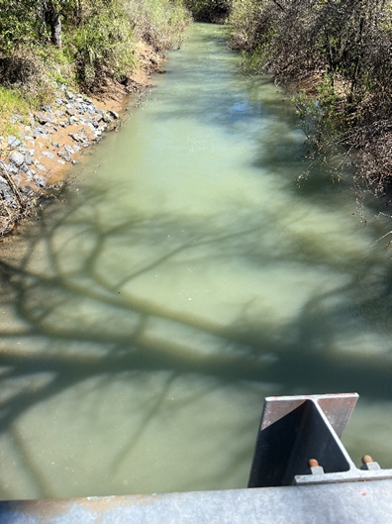
SURVEY VALIDATION
If site conditions are not ideal, then survey is not conducted and a reason is listed (dry, turbid, bloom, floating vegetation)
Water Visibility (turbidity)
  Reduces ability to positively ID fish species
Fish ID Confidence
  How confident are you with fish ID
Data randomly selected for QA/QC
  LCWPD double check in the field
Azolla
Duckweed
Dry
HAB
Turbid

Slide 6
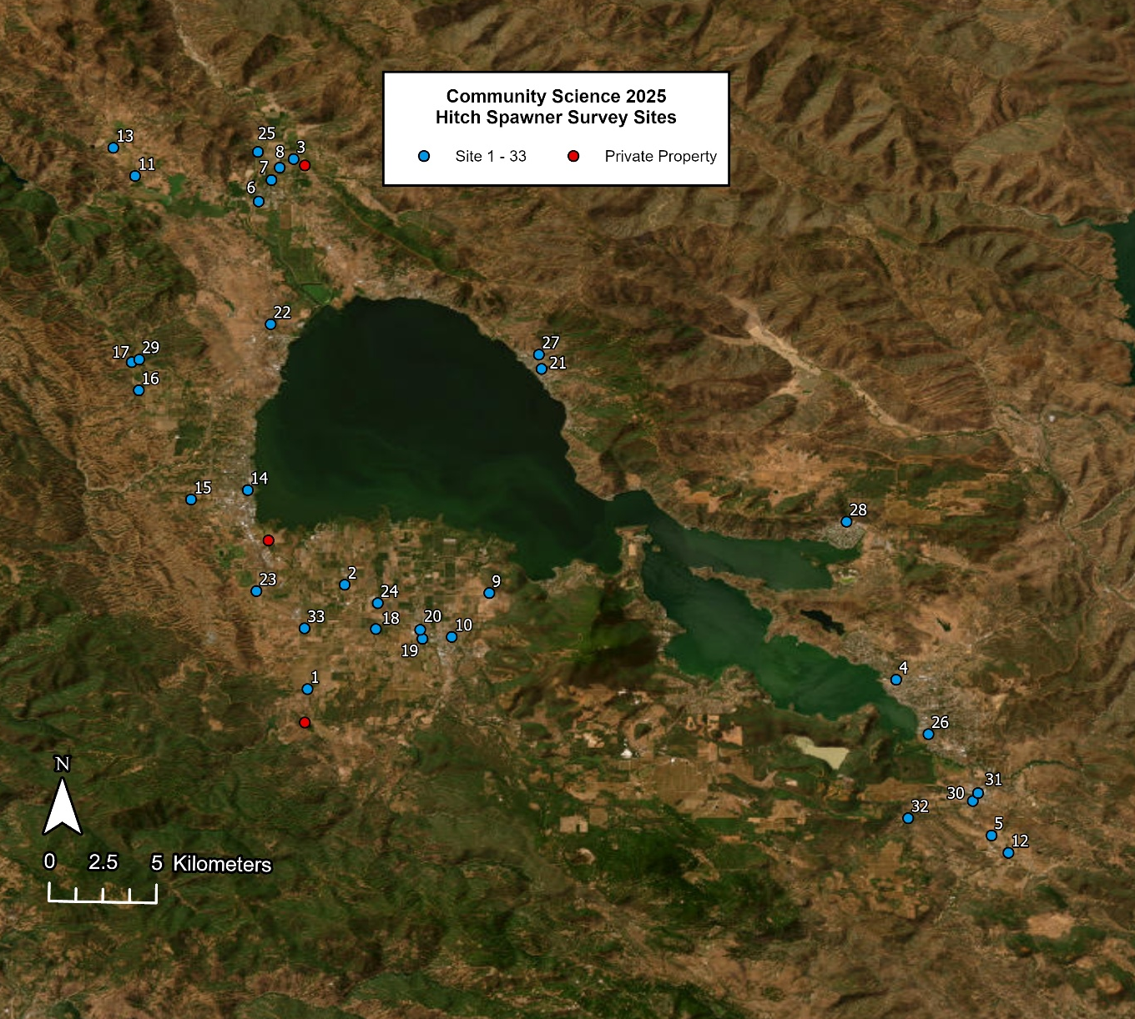
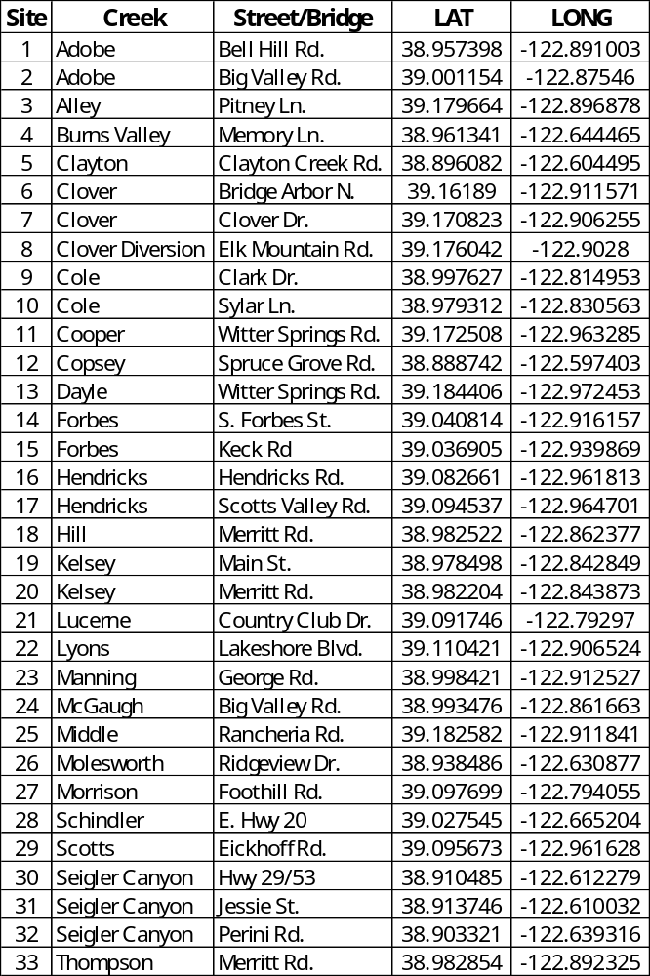
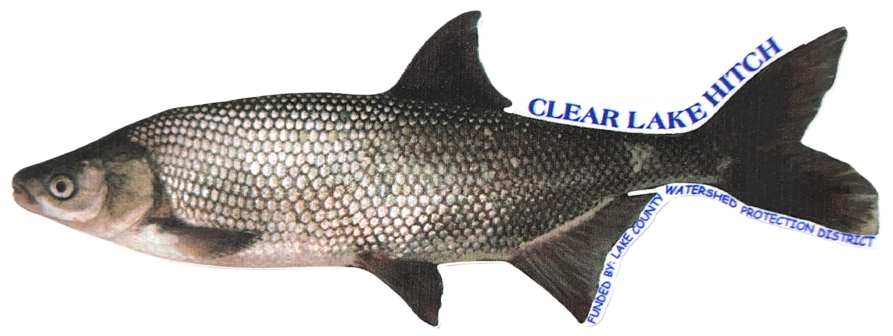
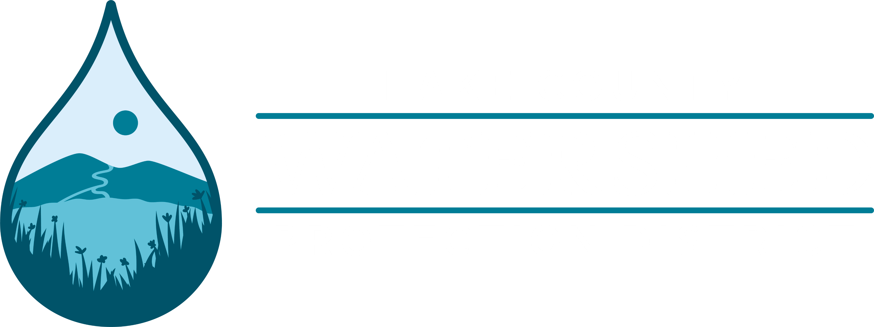
2026

Slide 7
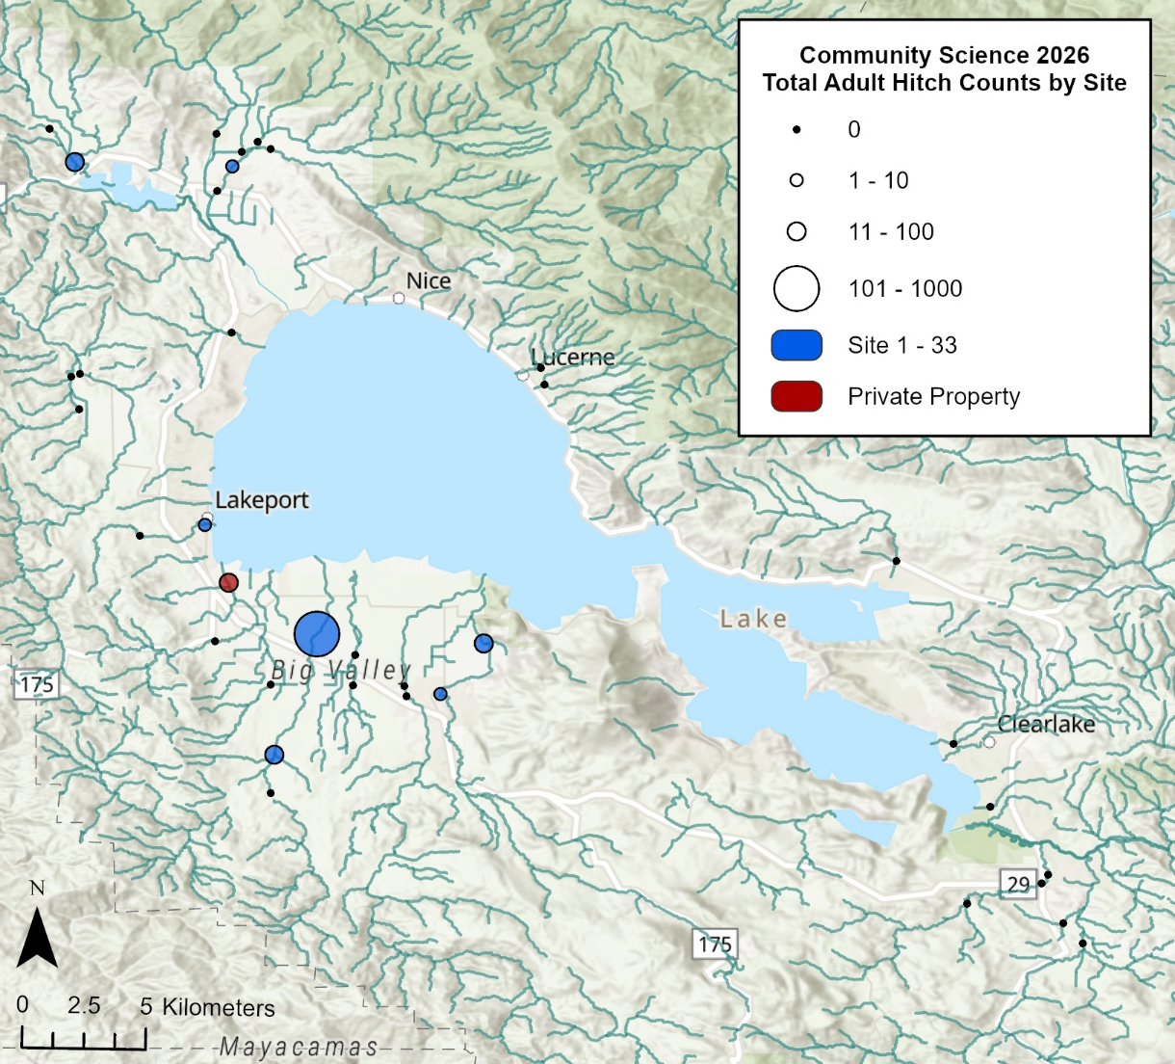
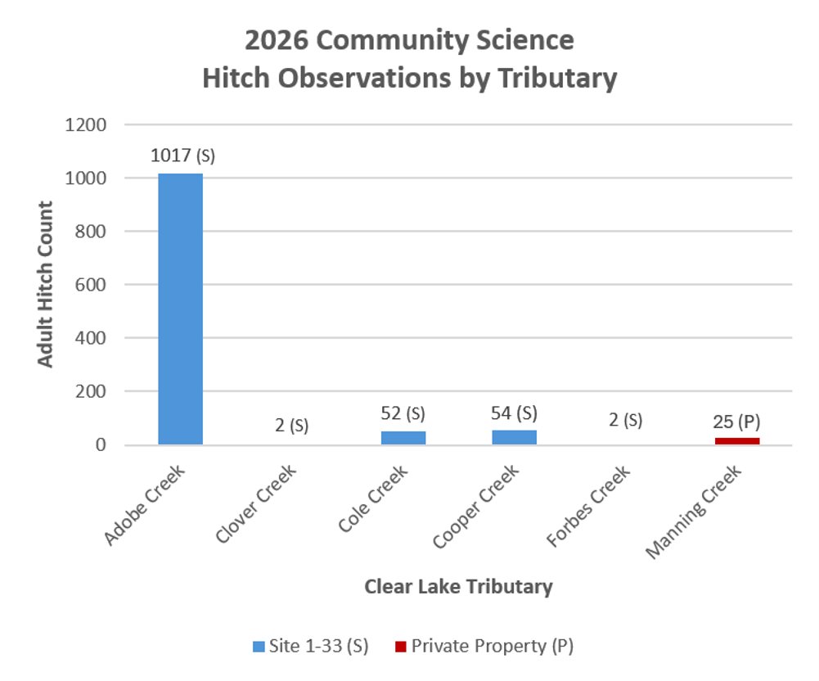
Preliminary 2026 Community Science Hitch Spawner Observation Data
Community Scientists observed 1,152 Clear Lake hitch in 2026
TOTAL: 1,152
* No hitch were observed in Alley, Burns Valley, Clayton, Clover Diversion, Copsey, Dayle, Hendricks, Hill, Kelsey, Lucerne, Lyons, Manning, McGaugh, Middle, Molesworth, Morrison, Schindler, Scotts, Seigler Canyon, or Thompson creeks.

Slide 8
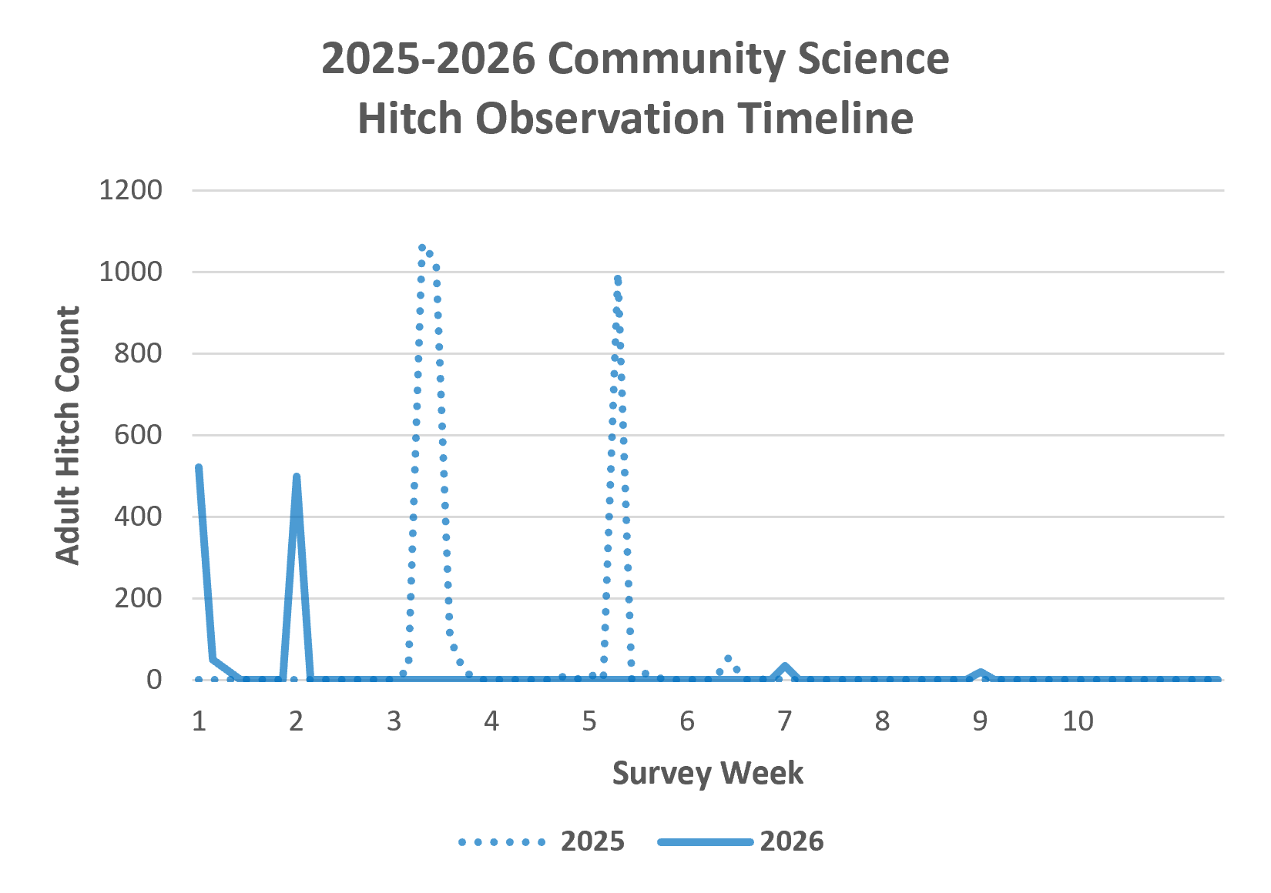
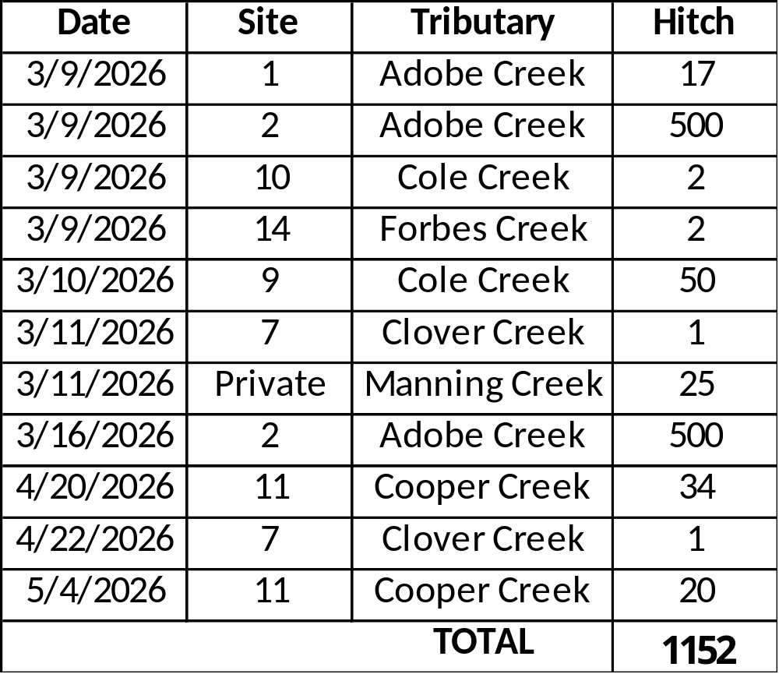
Preliminary 2026 Community Science Hitch Spawner Observation Data
2026 surveys began March 9 and continued through May 17.
Hitch spawning migration began approximately 1 month earlier in 2026.
Community scientists observed 3,347 hitch in 2025.
This dataset includes only survey records in which adult hitch were observed.

Slide 9
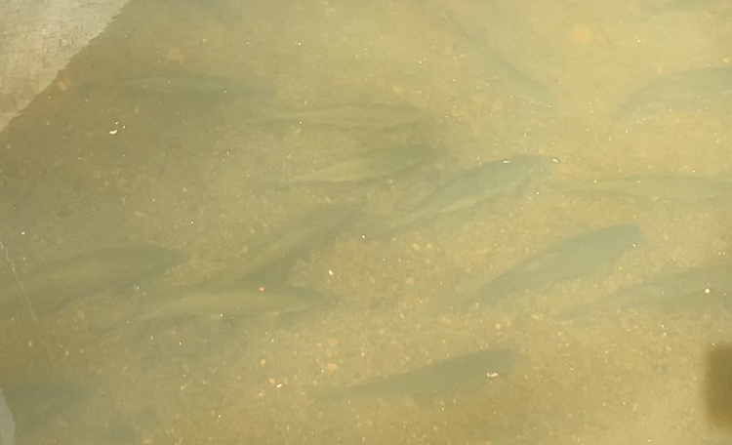
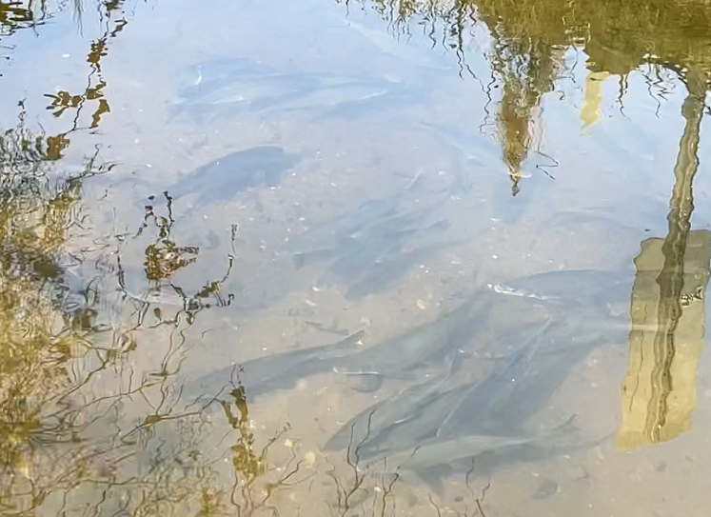
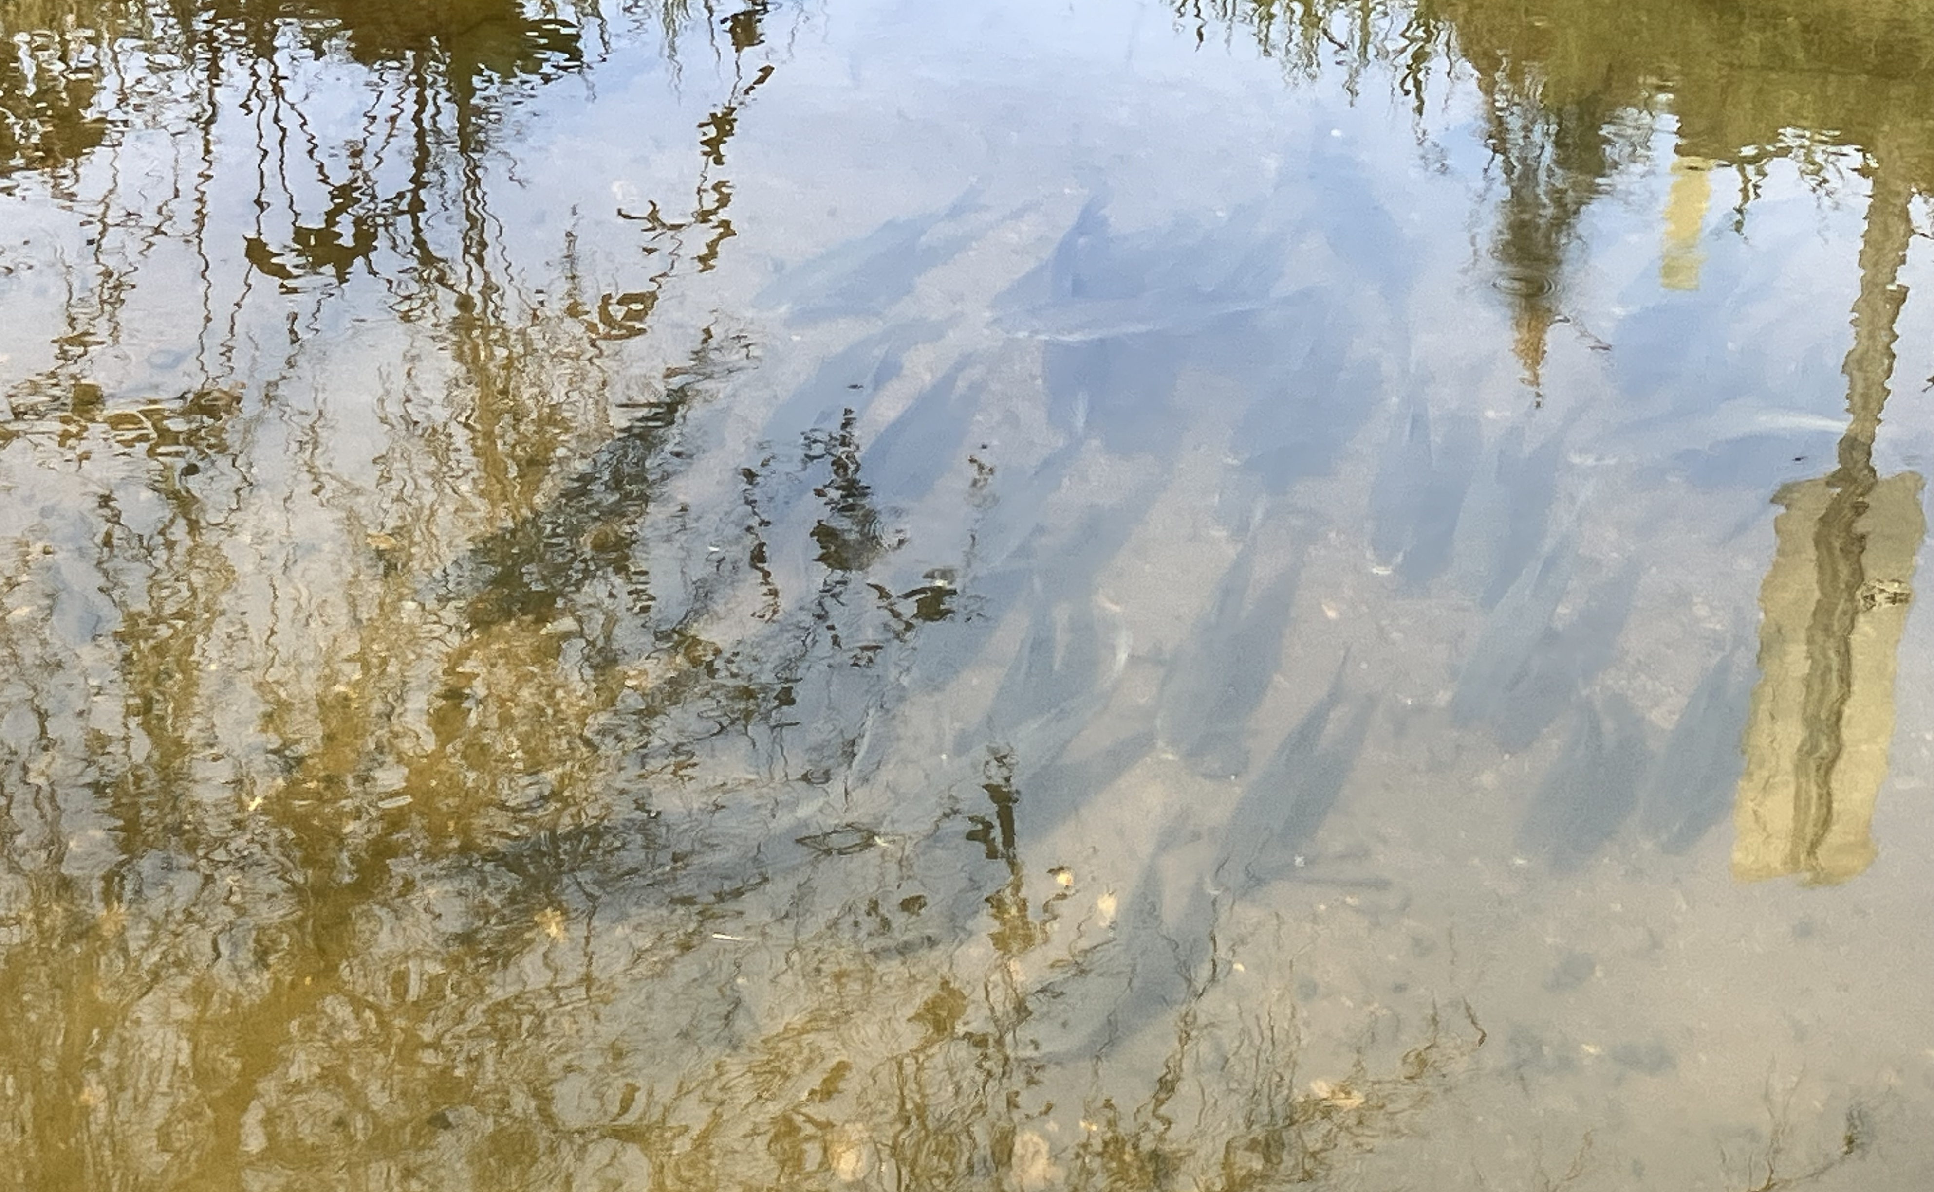
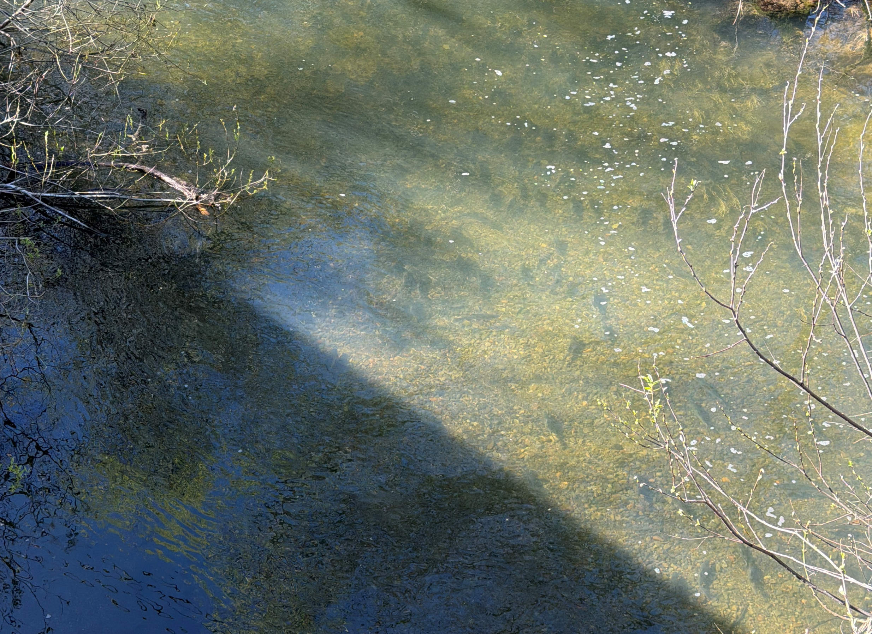
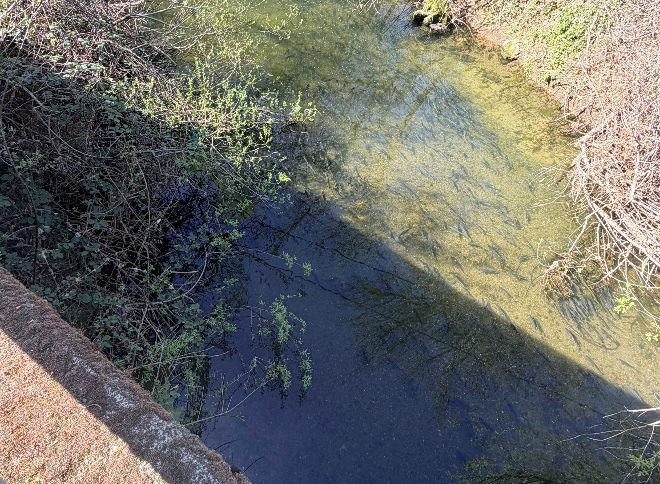
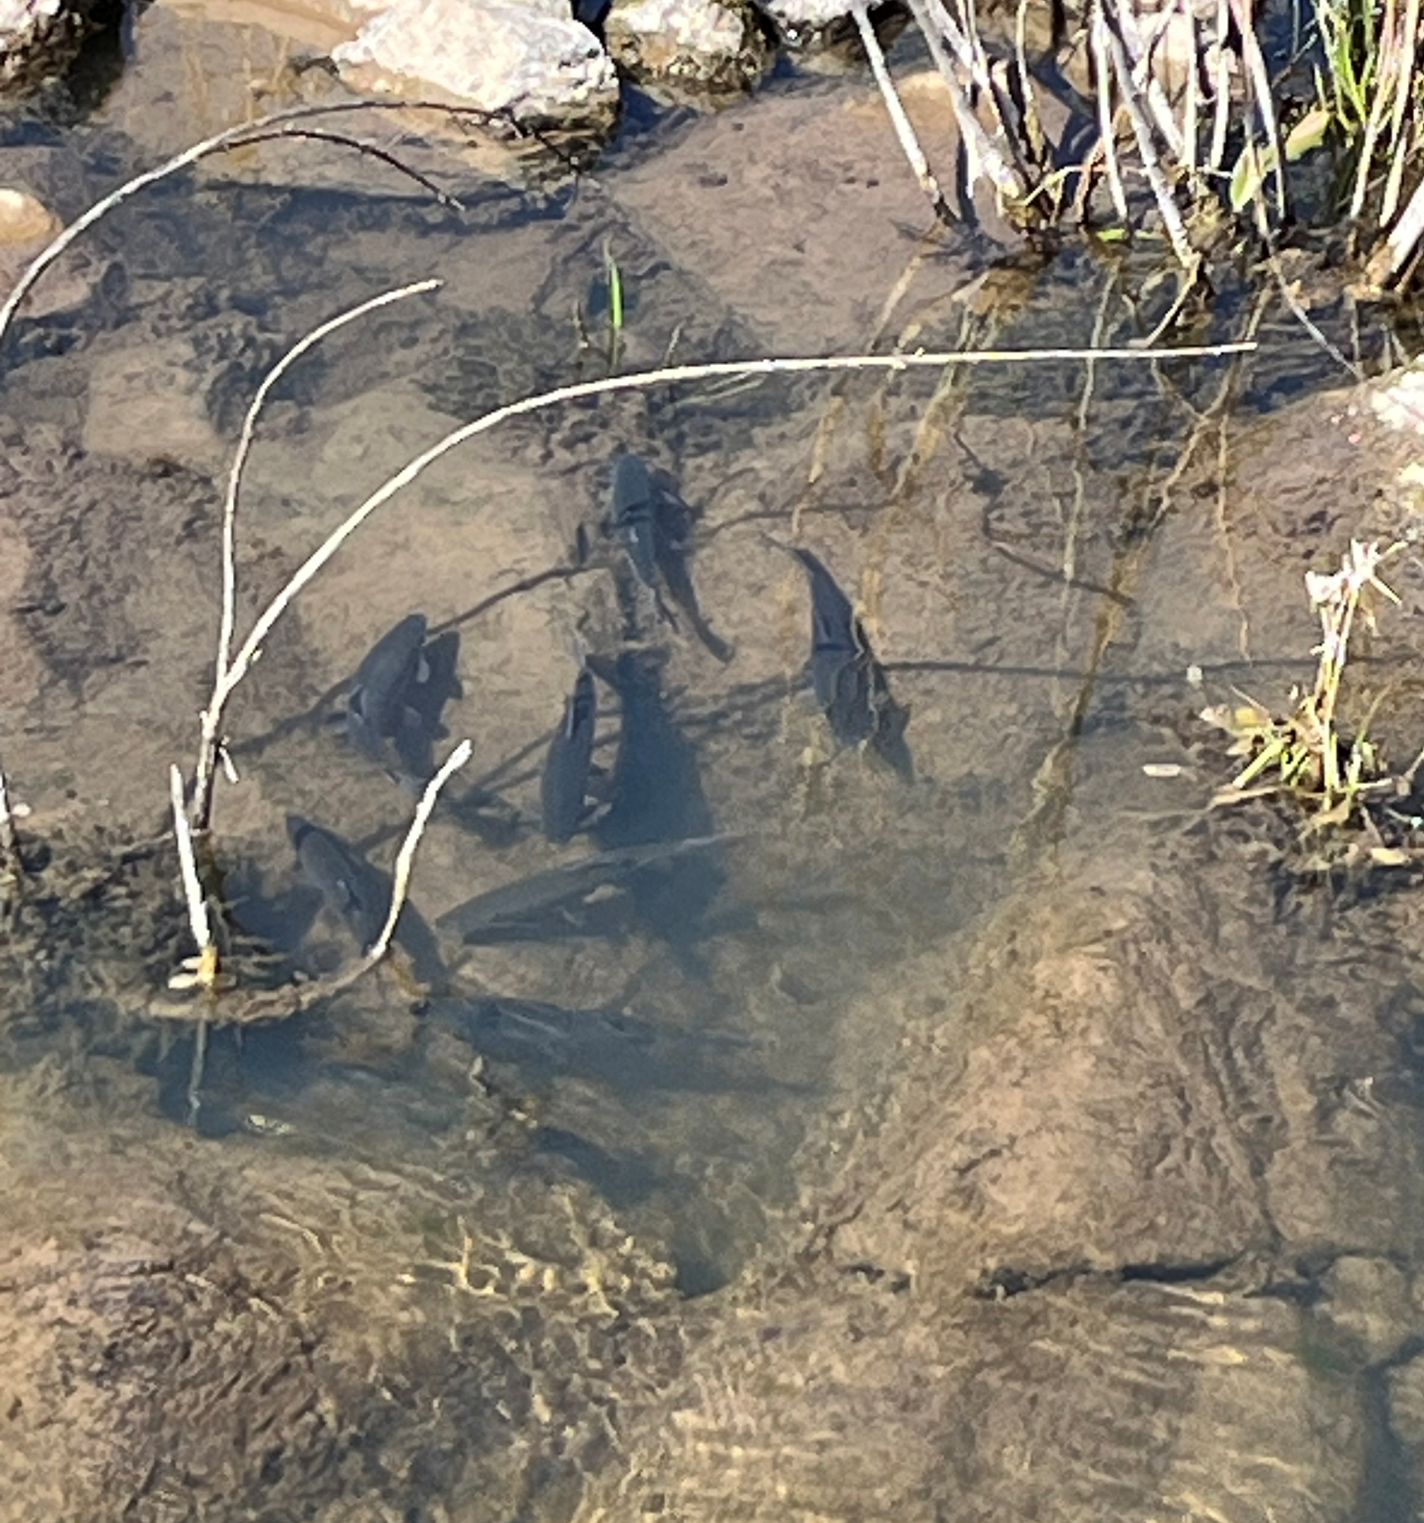
Preliminary 2026 Community Science Hitch Spawner Observation Data
Cole Creek 3/10/26 (K. Ziemer)
Cole Creek 3/10/26 (K. Ziemer)
Cole Creek 3/10/26 (K. Ziemer)
Adobe Creek 3/9/26 (T. Irace)
Adobe Creek 3/9/26 (B. Rasmussen)
Adobe Creek 3/16/26 (T. Irace)

Slide 10
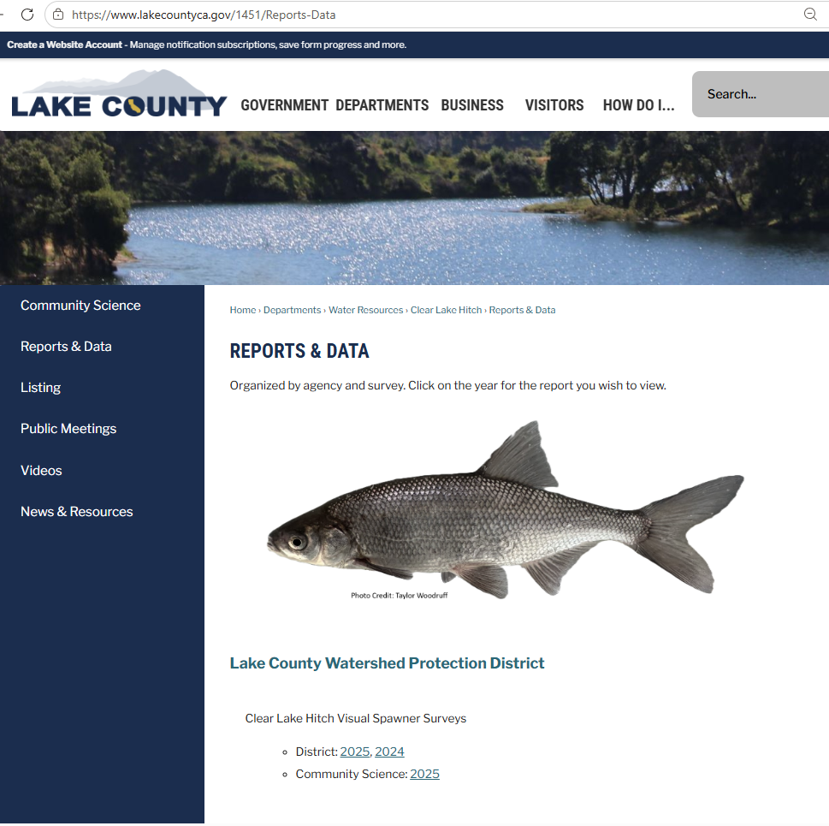
Reports
https://www.lakecountyca.gov/1451/Reports-Data
2026 Community Science report will be publicly available after internal review

Slide 11
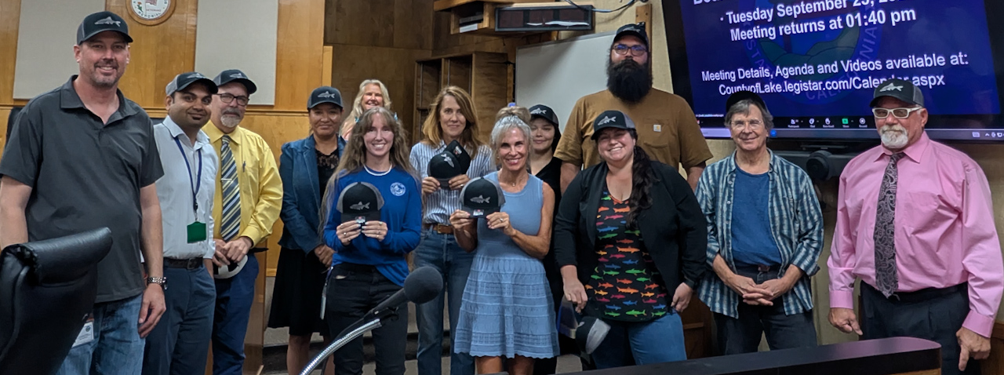
TRAININGS – February 2027
To participate, yearly training is mandatory
Instruction on fish identification
Training workshop with LCWPD in person
  Classroom training
  Field training
Contact us to sign up!

Slide 12
THANK YOU!
Our wonderful volunteers
Disney’s Screen Printing
City of Lakeport
Lake County Board of Supervisors
Lake County Water Resources Department
We couldn’t have done it without you!

Slide 13
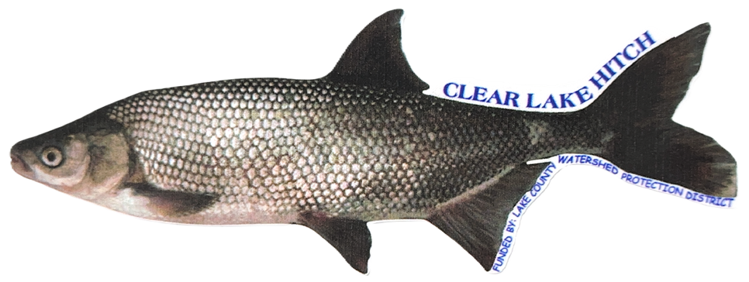


QUESTIONS/COMMENTS?
  CONTACT US
(707) 263-2344
chris.childers@lakecountyca.gov
taylor.woodruff@lakecountyca.gov
water.resources@lakecountyca.gov

